Slide 1
Software Verification Validation and Testing
Presented by : Neha Tripathi

Slide 2
Software Testing methodology
Software testing strategy
Test strategy matrix
Development of test strategy
Testing life cycle model
Validation activities
Testing tactics

Slide 3
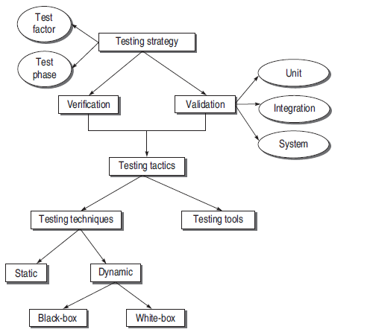
Software Testing methodology
Software testing methodology is the organization of software testing by means of which the test strategy and test tactics are achieved.

Slide 4
Software testing strategy
Testing strategy is the planning of the whole testing process into a well-planned series of steps.
In other words, strategy provides a roadmap that includes very specific activities that must be performed by the test team in order to achieve a specific goal.
The components of a testing strategy are:
Test Factors (Risk factors, ranked and reduce)
Test Phase (phases of SDLC where testing will be performed, different for different models).

Slide 5
Test strategy matrix
A test strategy matrix identifies the concerns that will become the focus of test planning and execution.
This matrix becomes an input to develop the testing strategy.
The matrix is prepared using test factors and test phase.
Test strategies generally must concentrate on risks associated with cost overruns, schedule slippage, critical software errors, and other failures.
The steps to prepare this matrix are discussed below:
Select and rank test factors
Identify system development phases
Identify risks associated with the system under development
Plan the test strategy for every risk identified

Slide 6
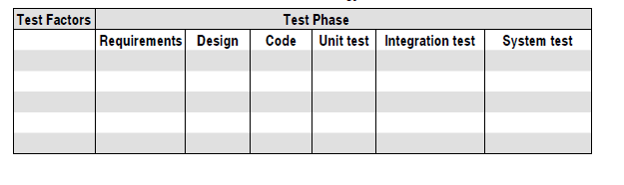
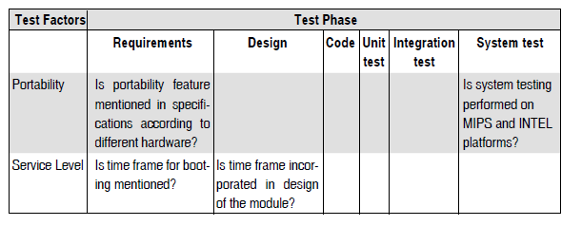
Test strategy matrix and example (to design a new OS)

Slide 7
Development of test strategy
When the project under consideration starts and progresses, testing too starts from the first step of SDLC. Therefore, the test strategy should be such that the testing process continues till the implementation of project.
The rule for development of a test strategy is that testing ‘begins from the smallest unit and progresses to enlarge’.
This gives rise to two basic terms—Verification and Validation
Testing process is a combination of verification and validation.

Slide 8
Verification:
The purpose of verification is to check the software with its specification at every development phase such that any defect can be detected at an early stage of testing and will not be allowed to propagate further.
That is why verification can be applied to all stages of SDLC.
So verification refers to the set of activities that ensures correct implementation of functions in a software.
Validation:
The validation process starts replacing the verification in the later stages of SDLC.
Validation is a very general term to test the software as a whole i.e., conformance with customer expectations.
According to Boehm :
Verification is ‘Are we building the product right?’
Validation is ‘Are we building the right product?’

Slide 9
Testing life cycle model
Verification and validation (V&V) are the building blocks of a testing process.
V&V can be best understood when these are modeled in the testing process.
This model is known as the Testing Life Cycle Model (V-testing model).
Life cycle involves continuous testing of the system during the development process.
V-Testing Life Cycle Model:
In V-testing concept, as the development team attempts to implement the software, the testing team concurrently starts checking the software.
When the project starts, both the system development and the system test process begin.
Both teams start at the same point using the same information.
If there are risks, the tester develops a process to minimize or eliminate them.
The V&V process, in a nutshell, involves
(i) verification of every step of SDLC and
(ii) validation of the verified system at the end.

Slide 10
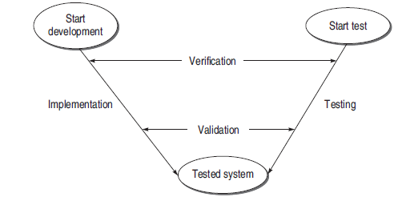
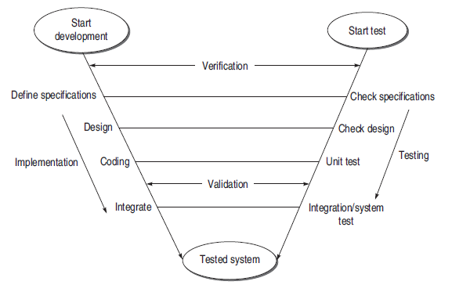
V- testing model
Expanded V- testing model

Slide 11
Validation activities
Validation has the following three activities which are also known as the three levels of validation testing.
Unit Testing (It is a major validation effort performed on the smallest module of the system.)
Integration Testing (It is a validation technique which combines all unit-tested modules and performs a test on their aggregation.)
System Testing (This testing level focuses on testing the entire integrated system.)

Slide 12
Testing tactics
Software Testing Techniques:
The technique used to design effective test case is called Software Testing Technique. These techniques can be categorized into two parts:
(a) static testing:
It is a technique for assessing the structural characteristics of source code, design specifications or any notational representation that conforms to well defined syntactic rules It is called as static because we never execute the code in this technique.
(b) dynamic testing:
All the methods that execute the code to test a software are known as dynamic testing techniques. In this technique, the code is run on a number of inputs provided by the user and the corresponding results are checked. This type of testing is further divided into two parts:
(i) black-box testing (functional testing)
(ii) white-box testing (structural testing)

Slide 13
Testing Tools:
Testing tools provide the option to automate the selected testing technique with the help of tools.
A tool is a resource for performing a test process.
The combination of tools and testing techniques enables the test process to be performed.
The tester should first understand the testing techniques and then go for the tools that can be used with each of the techniques.

Slide 14
Thank you!

